Slide 1

SQLite
Nguyen Truong Duong

Slide 2
Mission
SQLite

Slide 3
SQLite
SQLite is the embedded database of choice for both the iOS and Android mobile platforms
SQLite is called an embedded database because its primary use is to provide data persistence to your app, it is an integral part of your app.
Apps do not share Embedded Databases the way they share databases like Oracle amd DB2.

Slide 4
Application Access to SQLite
Core Data
An Apple provided Object-Relational Mapping framework.
Stores Objective-C objects into a SQLite Database object instance data looks like a row in an SQL table.

Slide 5
Application Access to SQLite
libsqlite3.0
Is a set of Objective C wrappers for SQLite.
Let you program using embedded SQL.

Slide 6
Core Data
Benefits
Supported by Apple.
Don't need to know SQL.

Slide 7
Core Data
Drawbacks
Does not work with RDBMS as the store.
Ordered relationships are hard.
Undo/Rollback doesn't always work.
Data migration to a revised model is hard .

Slide 8
libsqlite
Benefits
Easy to customize and use transaction.
Drawbacks
Have to know SQL.

Slide 9
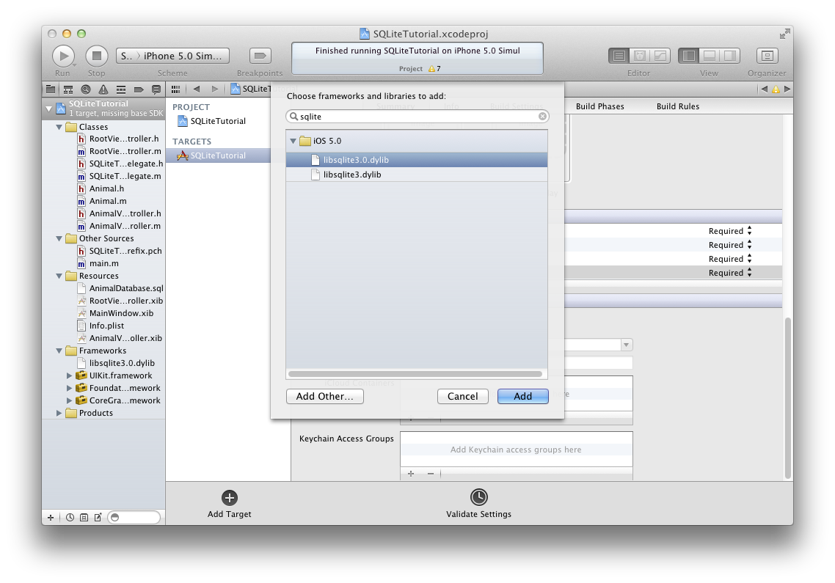

Slide 10
Using libsqlite
Open a database
sqlite3 *database;
sqlite3_open([databasePath UTF8String], &database);
Setup an SQL Statement
const char *sqlStatement = "select * from animals";
sqlite3_stmt *compiledStatement;
sqlite3_prepare_v2(database, sqlStatement, -1, &compiledStatement, NULL);

Slide 11
Using libsqlite
Release the statement from memory
sqlite3_finalize(compiledStatement);
Close the database
sqlite3_close(database);

Slide 12
Database Transaction
A transaction is a logical unit of work that contains one or more SQL statements.
A transaction is an atomic unit.
The effects of all the SQL statements in a transaction can be either all committed (applied to the database) or all rolled back (undone from the database).

Slide 13
Database Transaction
Start a transaction with: sqlite3_exec(db, "BEGIN", 0, 0, 0);
Commit a transaction with: sqlite3_exec(db, "COMMIT", 0, 0, 0);
Rollback a transaction with: sqlite3_exec(db, "ROLLBACK", 0, 0, 0);

Slide 14
SQL Injection
An SQL injection is often used to attack the security of a website by inputting.

Slide 15
Example
statement = "SELECT * FROM users WHERE name = '" + userName + "';"
Setting the "userName" variable as
' or '1'='1
Renders the SQL
SELECT * FROM users WHERE name = '' OR '1'='1';

Slide 16
const char *sqlQuery = "INSERT into Contacts (FirstName, LastName, Email, Telephone) Values(?, ?, ?, ?)";
sqlite3_stmt *query = nil;
int retVal;
if ((retVal = sqlite3_prepare_v2(dbHandle, sqlQuery, -1, &query, NULL)) == SQLITE_OK) {
sqlite3_bind_text(query, 1, [contactFirstName UTF8String], -1, SQLITE_TRANSIENT);
...
}

Slide 17
Questions?

